Slide 1
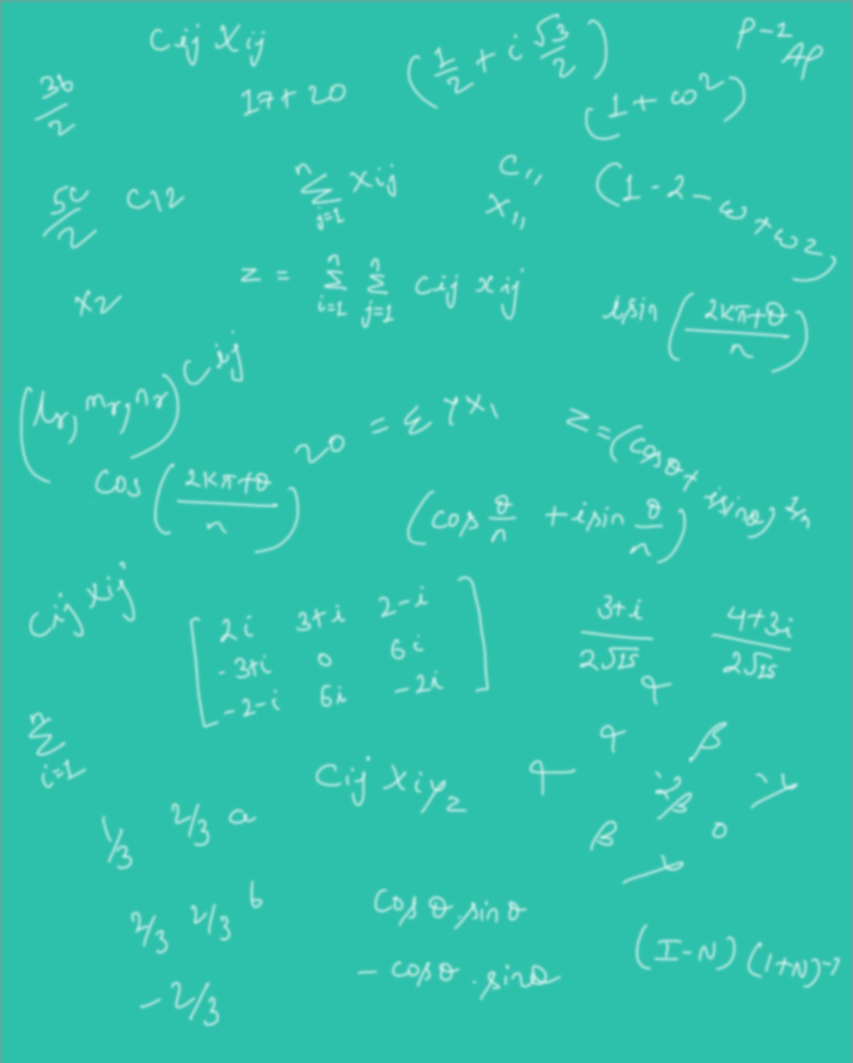







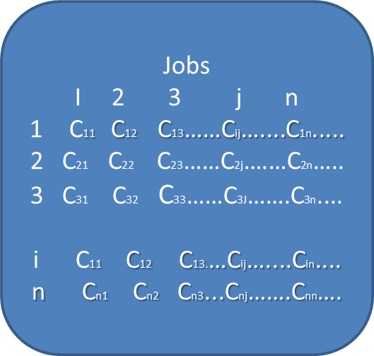



K. J. Somaiya College of Engineering, Mumbai – 400 077
(A Constituent College of Somaiya Vidyavihar University) Dept. of Science and Humanities
F.Y. B. Tech. Semester –I (2022-23)
Applied Mathematics-I
IA-I
Application of Matrices in Assignment Problem
NAME : Akshat Yadav
ROLL NO. : 16010122221
DIV: C3 BATCH: 3
Definition
The assignment problem is a special case of transportation problem in which the objective is to assign ‘m’ jobs or workers to ‘n’ machines such that the cost incurred is minimized.
Supply at any source (machine)will be 1. i.e.,a_{i} = 1.
Demand at any destination (job) will be 1. i.e.,b_{j} = 1.
One source (machine) to only one destination (job).
The assignment problem can be stated that in the form of mxn matrix c_{ij} called a Cost Matrix (or) Effectiveness Matrix where c_{ij} is the cost of assigning i ^{th} machine to j^{th} job.
The problem of assignment arises because available resources such as men, machines etc. have varying degrees of efficiency for performing different activities, therefore, cost, profit or loss of performing the different activities is different.
Mathematically an assignment problem can be stated as follows minimize the total cost.
Where xij=1,if i^{th} person is assigned to the j^{th} job
Subject to the constraints
(i)
Which means that only one job is done by the i^{th} person,i=1,2---n
^{(ii)}
Which means that only one one person should be assigned to the j^{th} job,j=1,2---n
Persons

Slide 2
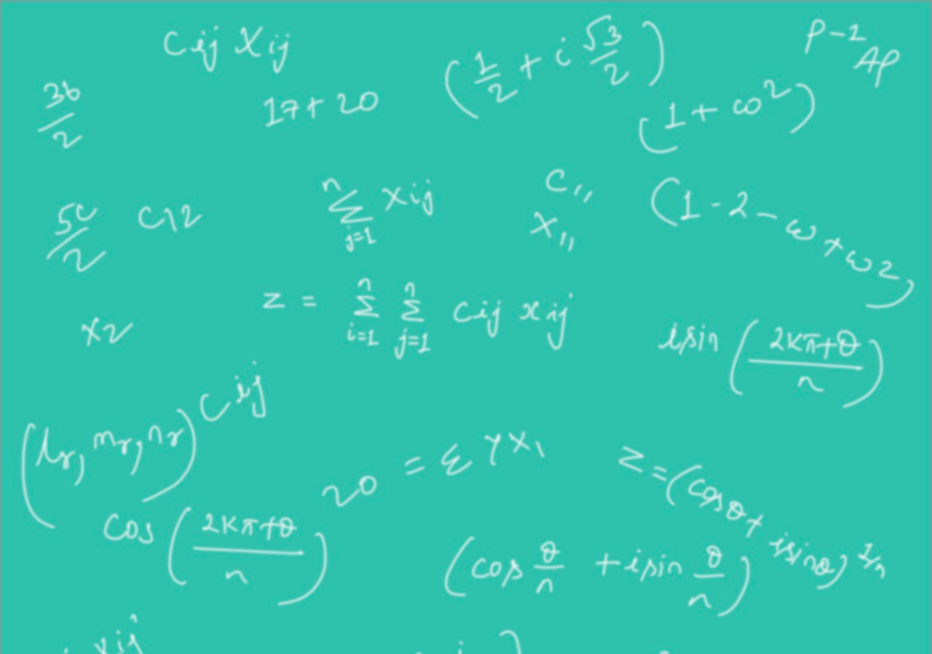



Method for solving assignment problem
0 | 6 | 11
0 | 3 | 4
0 | 0 | 0
Let's take an example to understand it better,
Determine the cost table from the given problem
Now draw Horizontal and vertical lines
Three jobs A B C are to be assigned to three machines x Y Z. The processing costs are as given in the matrix shown below. Find the allocation which will minimize the overall processing cost.
Here, no of horizontal lines is one and vertical line is one The order of matrix is 3 x 3, therefore, N≠ n
Machines
Jobs
 | X | Y | Z
A | 19 | 28 | 31
B | 11 | 17 | 16
C | 12 | 15 | 13
Now, in the uncrossed cell the least cost is selected and subtracted for the remaining uncrossed cell by the least value and for the intersection of the horizontal line and vertical line the least value should be added and the resulting matrix.
0 | 3 | 8
0 | 0 | 1
3 | 0 | 0
The above matrix has two horizontal line and one vertical line which satisfies our condition N= n
Row Minimization
0 | 9 | 12
0 | 6 | 5
0 | 3 | 1
Step 1: create zero in each row or column by subtracting by selecting least number in each row and column
{0} | 3 | 8
0 | {0} | 1
3 | 0 | {0}
References:-
https://www.engineeringenotes.com/project-management-2/operations-research/assignment-problem-meaning-methods-and-variations-operations-research/15652
https://drive.google.com/file/d/1JUcXGw19ZAh5-RPx49jhVvjnRg7fvYiA/view?usp=sharing
Column Minimization
0 | 6 | 11
0 | 3 | 4
0 | 0 | 0
The assignment are A X=19
B X=17
C Z=13
49

